Slide 1
Chapter 13 Introduction to the Transport Layer

Slide 2
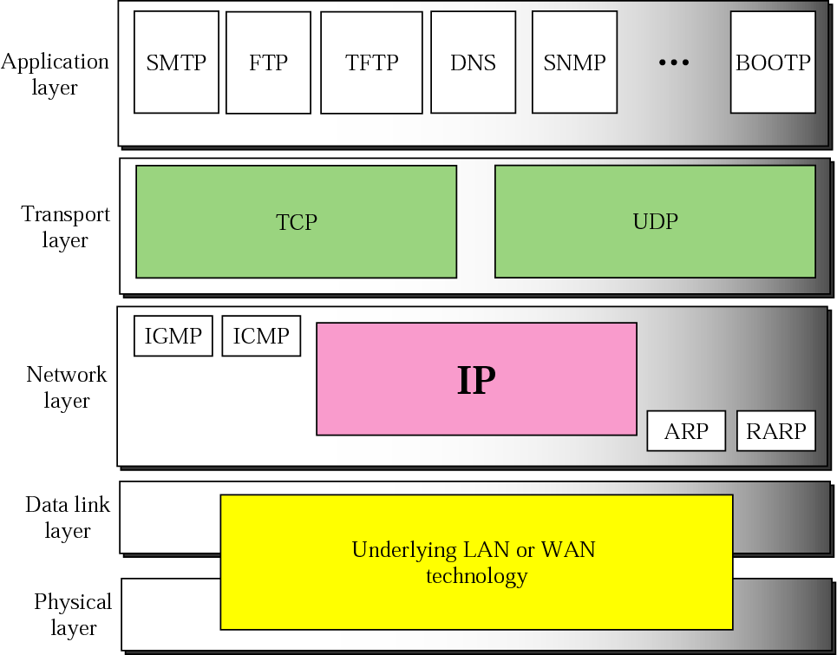
Figure 8-1
Position of IP in TCP/IP Protocol Suite
The McGraw-Hill Companies, Inc., 2000

Slide 3
Outline
Transport-layer services
Transport-layer protocols

Slide 4
Transport-Layer Services
Process-to-process communication
Addressing: Port Numbers
Encapsulation and Decapsulation
Multiplexing and Demultiplexing
Flow Control
Error Control
Combination of Flow and Error Control
Congestion Control
Connectionless and Connection-Oriented Services

Slide 5
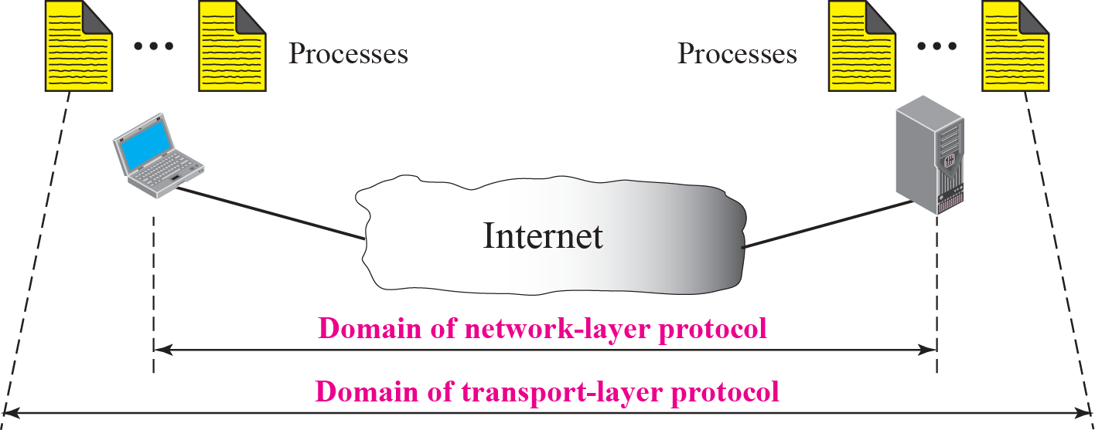
Process-to-Process Communication
Network layer: host-to-host communication
Deliver the message to the destination computer
Transport layer: process-to-process communication
Deliver the message to the appropriate process

Slide 6
Addressing: Port Numbers
To achieve process-to-process communication: client-server paradigm
Example:
Ftp client and ftp server
WWW server and WWW client (browser)
…..

Slide 7
Addressing: Port Numbers (Cont.)
Port numbers: define the processes
0~65535
Well-known port numbers
Servers needs to be assign a universal port number
So that client process knows the port number of the server process
However, client’s port number can be defined randomly
Ephemeral (=short lived) port number

Slide 8
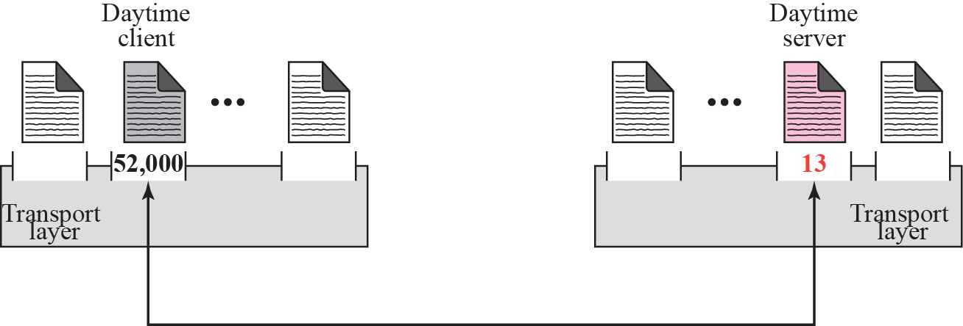
Figure 11-3
Port Numbers
The McGraw-Hill Companies, Inc., 2000

Slide 9
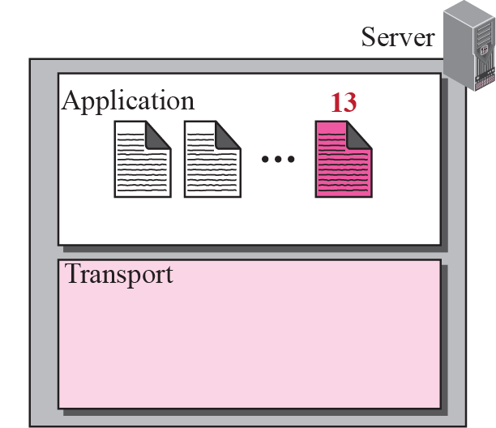
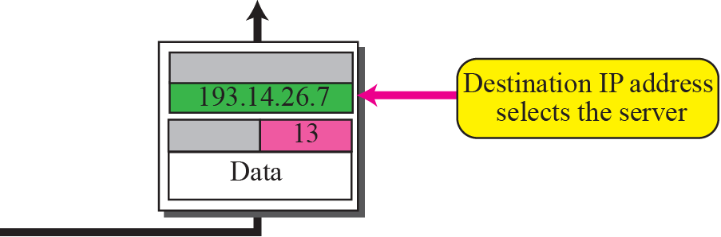
Figure 11-4
IP Addresses Versus Port Numbers
The McGraw-Hill Companies, Inc., 2000

Slide 10
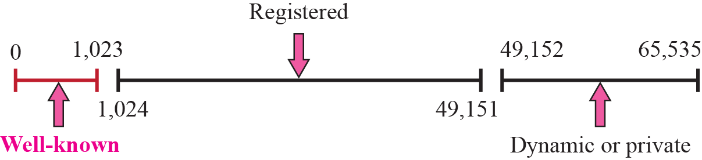
IANA Ranges
The IANA divides the port numbers into three ranges
Well-known ports: assigned and controlled by IANA
0~1,023
Registered ports: not assigned or controlled by IANA
1,024~49,151
Can only be registered with IANA to prevent duplication
Dynamic (or private) ports: neither controlled nor registered
49152~65535
Ephemeral ports and can by used by any process

Slide 11
Example 13.1
In UNIX, the well-known ports are stored in a file called /etc/services. Each line in this file gives the name of the server and the well-known port number. We can use the grep utility to extract the line corresponding to the desired application. The following shows the port for TFTP. Note that TFTP can use port 69 on either UDP or TCP. SNMP (see Chapter 24) uses two port numbers (161 and 162), each for a different purpose.

Slide 12
Socket Addresses
Transport layer protocol needs two identifiers at each end
The IP addresses
The port numbers
Socket address
The combination of an IP address and a port number
Thus, we need a pair of socket addresses for a transport layer communication
Client socket address and server socket address

Slide 13
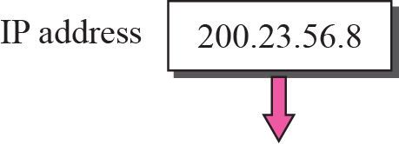
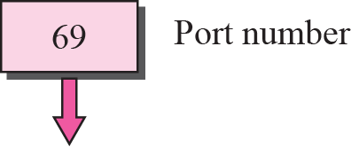

Figure 11-6
Socket Addresses
The McGraw-Hill Companies, Inc., 2000

Slide 14
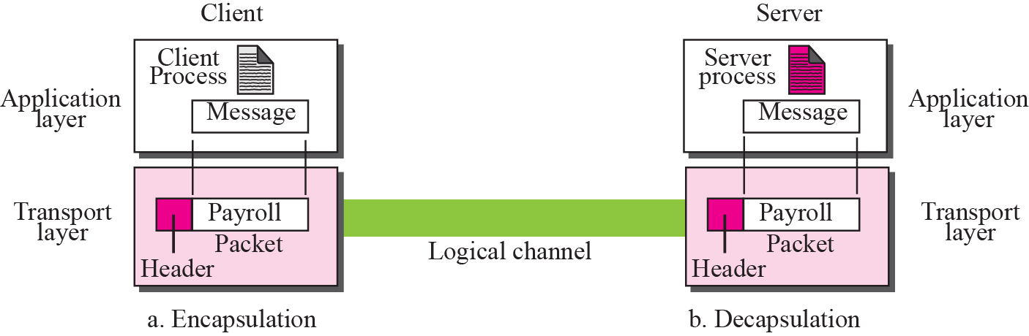
Encapsulation and Decapsulation in the Transport Layer

Slide 15
Multiplexing and Demultiplexing
Multiplexing (many to one)
Performed at the source
Accepts item from more than one source
Demultiplexing (one to many)
Performed at the destination
Deliver item to more than one source

Slide 16
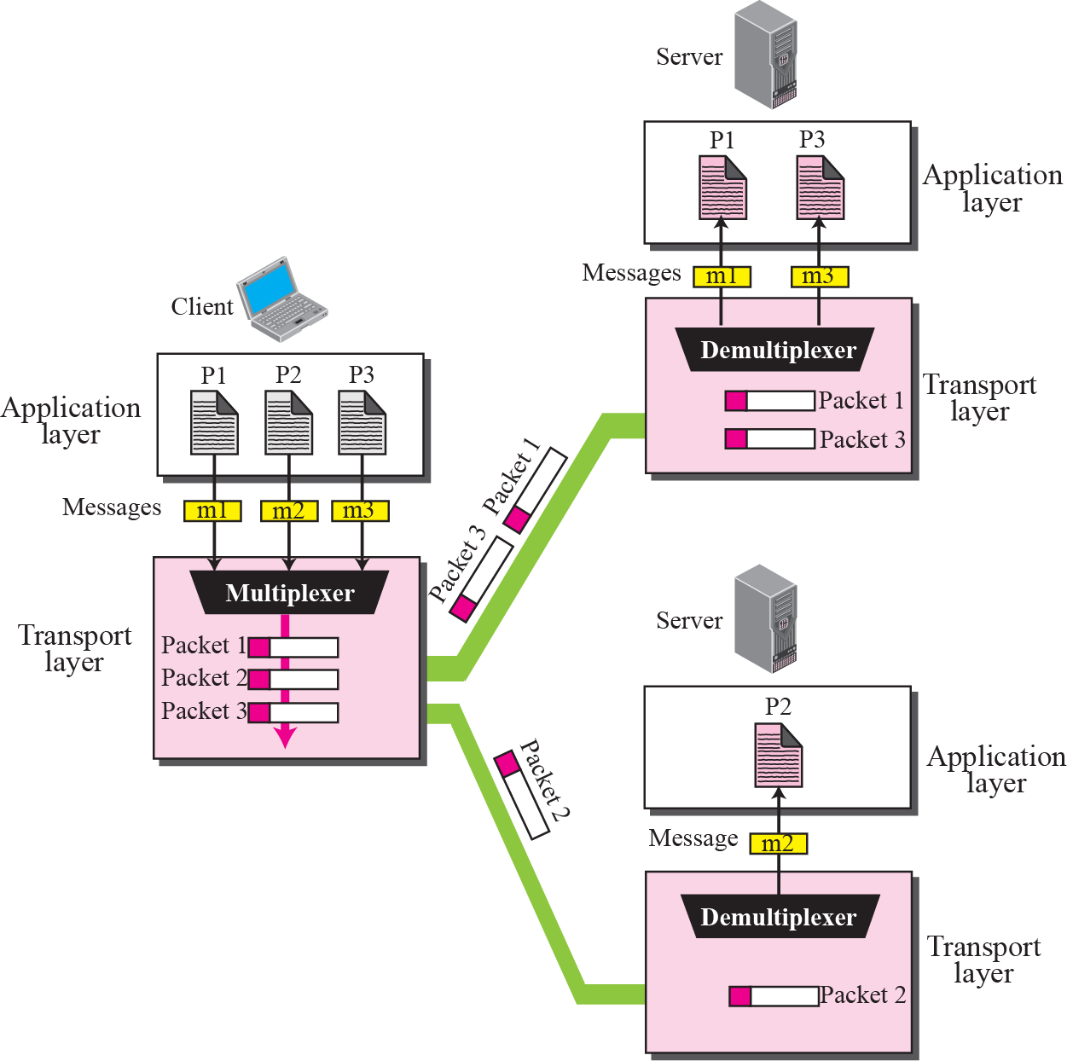
Multiplexing and Demultiplexing

Slide 17
Flow Control
There should be a balance between producer and consumer
If the items are produced faster than are consumed
The consumer can be overwhelmed and discard items
If the items are produced slower than are consumed
The consumer should wait and system is less efficient
Flow control:
Related to the first issue
Prevent losing the packets at the consumer site

Slide 18
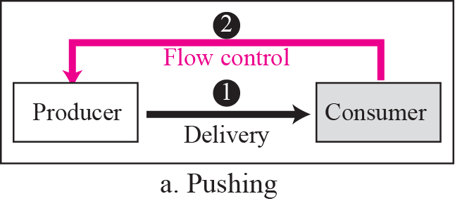
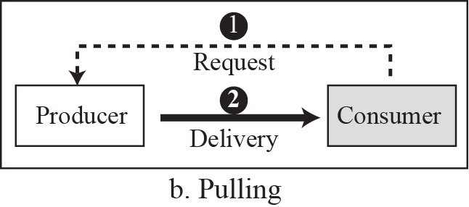
Pushing or Pulling
Delivery of items from a producer has two ways
Pushing:
Deliver items without the prior request from the consumer
The consumer may be overwhelmed
Need flow control
Pulling
Deliver items after the consumer has requested them
No need for flow control

Slide 19
Flow Control at the Transport Layer
As shown in next slide, at least two cases of flow control
From the sending transport layer to the sending application layer
From the receiving transport layer to the sending transport layer
The receiving application layer to the receiver transport layer is a pulling delivery
The transport layer waits until the application-layer process asks for message

Slide 20
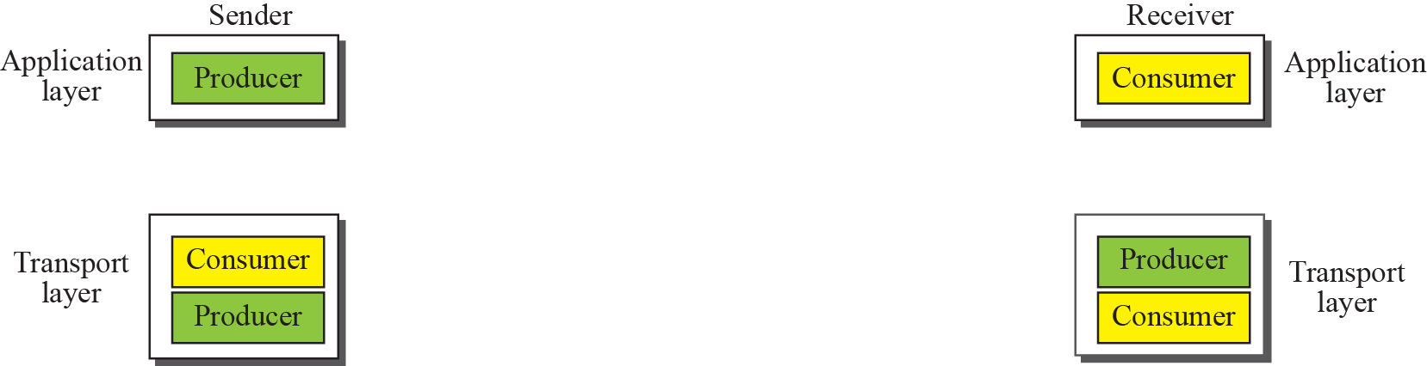
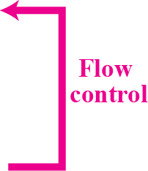
Flow Control at the Transport Layer (Cont.)

Slide 21
Buffers
One solution to flow control is using two buffers
One at the sending transport layer and the other at the receiving transport layer
In the buffer in the sending transport layer
If it is full: inform the application to stop passing message
If it has vacancies, inform application to pass message
In the buffer in the receiving transport layer
If it is full: inform the sending transport layer to stop sending
If it has vacancies, inform the sending transport layer to send message

Slide 22
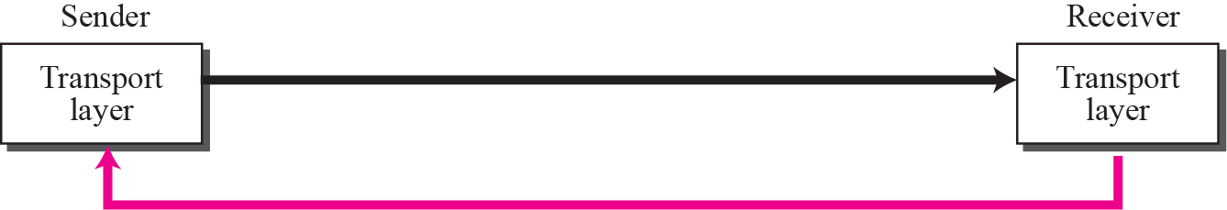
Error Control
Error control at the transport layer
Detect and discard corrupted packets
Keep track of lost and discarded packets and resend them
Recognize duplicated packets and discard them
Buffer out-of-order packets until the missing packet arrives
Packets
Error Control

Slide 23
Sequence Number
To know which packet is lost, duplicated, or out-of-order
Each packet must be numbered
Solution: sequence number
Note that, sequence number can wrap around
Example: if sequence number is 4 bits, then
0, 1, 2, 3, 4, 5, 6, 7, 8, 9, 10, 11, 12, 13, 14, 15, 0, 1, 2, 3, 4, 5, 6, …..

Slide 24
Acknowledgment
Acknowledgment
Positive acknowledgment
Send an acknowledgement for packets that have arrived safe and sound
Negative acknowledgment
Send an acknowledgement for packets that are not arrived or corrupted

Slide 25
Combination of Flow and Error Control (Skip!)
Flow control: needs two buffers
Error control: define sequence number and acknowledgement number
Combination of flow and error control
Two numbered buffers with the sliding window mechanism

Slide 26
Combination of Flow and Error Control (Skip!)
Example: as shown in the following slide
The buffer is numbered
Assume that the sequence number is 4 bits
Thus, the buffer is numbered from 0 to 15
Assume that the size of window is 7
However, most protocols show the sliding window using linear representation
Shown in the next following slide

Slide 27
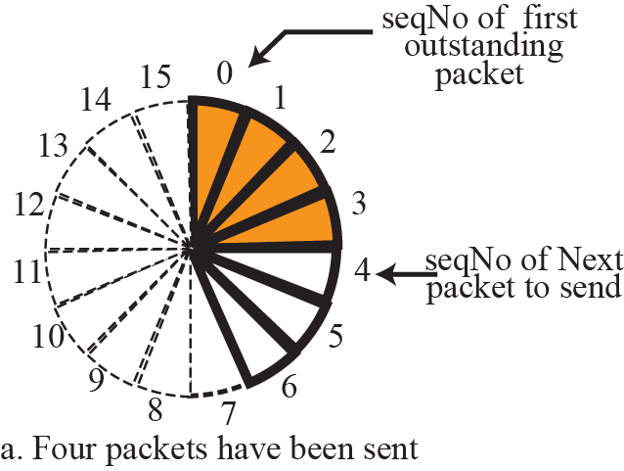
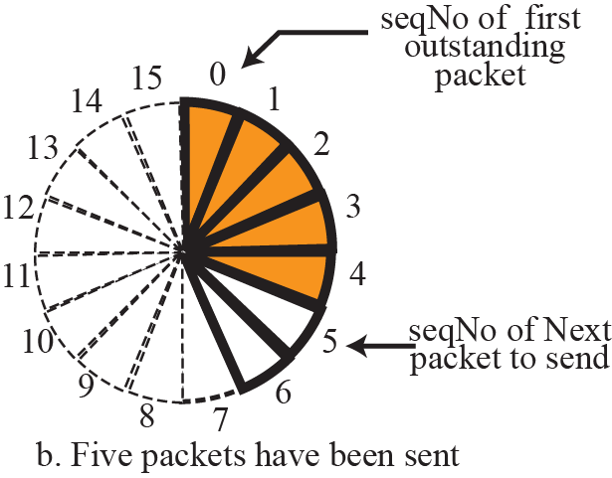
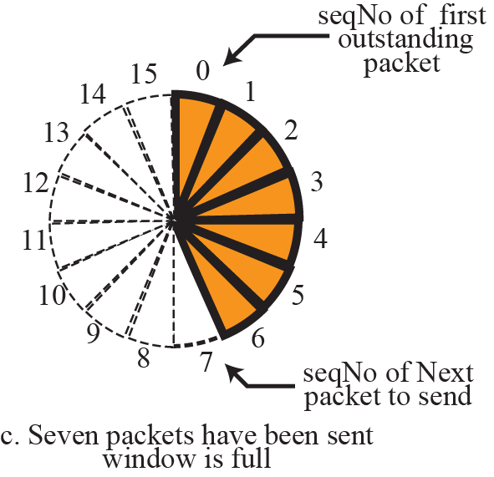
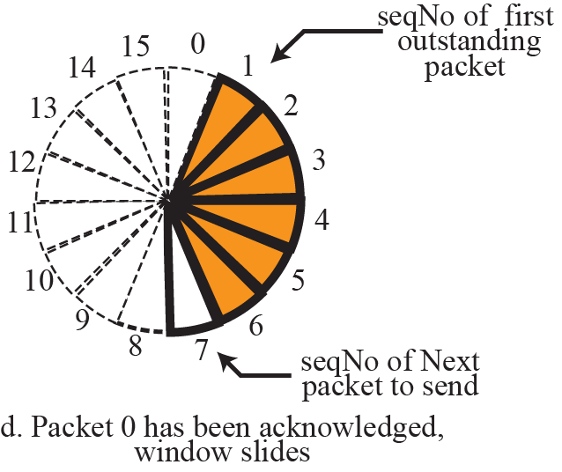
Sliding Window in Circular Format (Skip!)

Slide 28
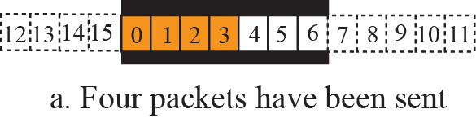
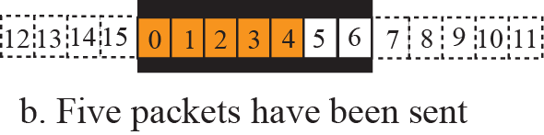
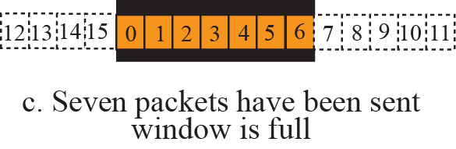
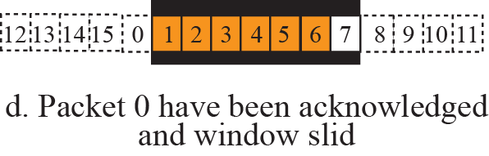
Sliding Window in Linear Format (Skip!)

Slide 29
Congestion Control
Congestion
The load on the network is greater than the capacity of the network
Why?
An internet is a combination of networks and connecting devices, e.g., routers and switches
A router/switch has queues that store the incoming packets, processes them, and forward them.

Slide 30
Congestion Control (Cont.)
In the following features,
Input queue may be congested
Packet arrival rate > packet processing rate
Output queue may be congested
Packet departure rate < packet processing rate

Slide 31
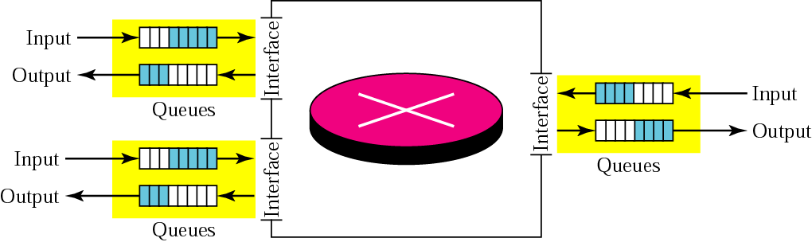
Figure 12-14
Router Queue
The McGraw-Hill Companies, Inc., 2000

Slide 32
Congestion Control Mechanism
Congestion control
Prevent congestion before it happens
Remove congestion after it happens
Two categories
Open-loop congestion control (prevention)
Closed-loop congestion control (removal)

Slide 33
Open-Loop Congestion Control
Prevent congestion before it happens
Possible policies
Retransmission policy
Retransmission policy and retransmission timer should be designed to optimize efficiency
Acknowledgment policy
Does not ACK every packet it receives
Discard policy
Router should adopt good discard policy

Slide 34
Closed-Loop Congestion Control
Try to alleviate congestion after it happens
Possible mechanisms
Back pressure
When a router is congested, it can inform the previous upstream router to reduce it outgoing rate
The action can be recursive all the way to the router just prior to the source
Choke Point
A router sends a packet to the source to inform congestion
This packet is called chock point, like ICMP’s source quench packet
Implicit signaling
Source can detect an implicit signal warning of congestion
For example, the delay in receiving an acknowledgment
Explicit signaling
Router can send an explicit signal to the sender or receiver of congestion
For example, set a bit in a packet

Slide 35
Connectionless and Connection-Oriented Services
Transport-layer protocol, like network-layer protocol can provide two types of services
Connectionless and connection-oriented
However, they have different meaning
Network-layer protocol
Connectionless service:
Mean different paths for different datagrams belonging to the same message
Connection-oriented service
In contrast

Slide 36
Connectionless and Connection-Oriented Services (Cont.)
Transport-layer protocol: does not concern with the physical paths of packets
Connectionless service:
Mean independency between packets
Connection-oriented service
Mean dependency between packets

Slide 37
Connectionless Services
Each packet is independent
Even coming from the same source process
Thus, packet may
be arrived out-of-order, lost, or duplicate
No flow control, error control, and congestion control can be effectively implemented in a connectionless service

Slide 38
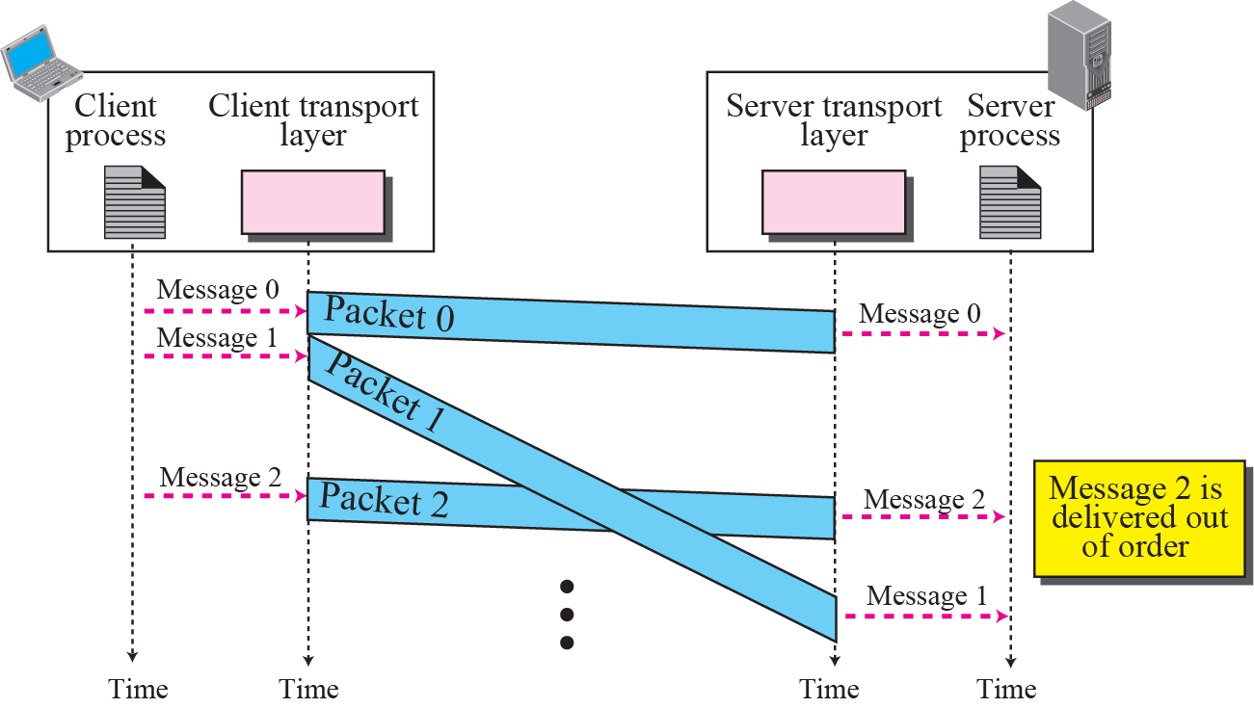
Connectionless Service

Slide 39
Connection-Oriented Services
In the network layer
Needs a coordination between the two end hosts and all the routers in between
In transport layer
Only involves the two ends; the service is end-to-end
Thus, a connection-oriented transport-layer protocol can be made over either a connectionless or connection-oriented network-layer protocol

Slide 40
Connection-Oriented Services (Cont.)
As shown in the next slide, need three phase
Connection establishment
Data transfer
Tear-down phases
Flow control, error control, and congestion control can be effectively implemented in a connection-oriented service

Slide 41
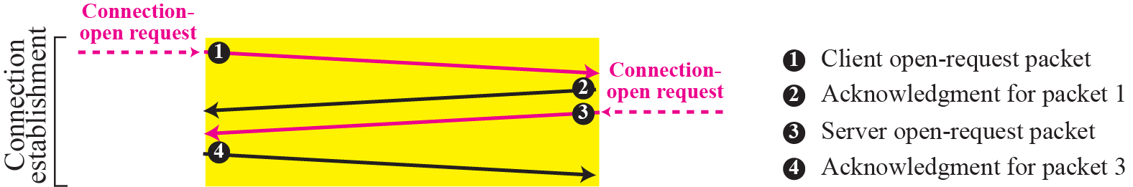
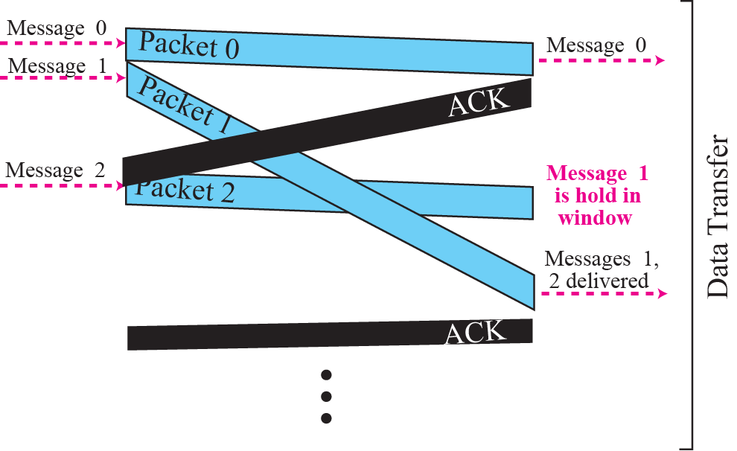
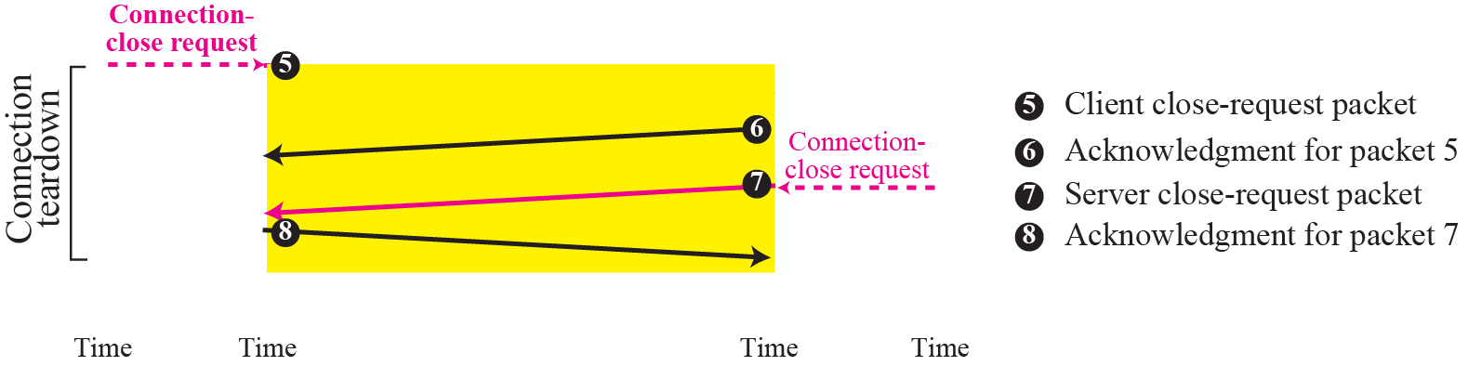

Slide 42
Outline
Transport-layer services
Transport-layer protocols (Skip!)

